Slide 1





HEAPS AND AVL TREES
Dr. Priyanka N
Assistant Professor Senior Grade 1
School of Computer Science & Engineering VIT,Vellore.

Slide 2

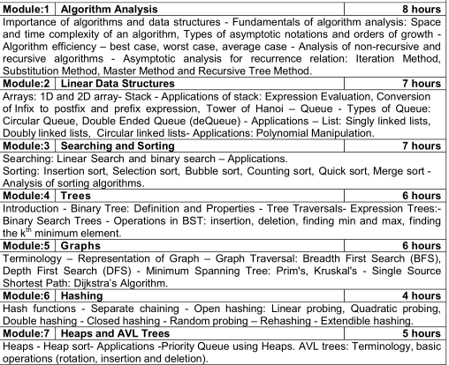

Slide 3

HEAPS AND AVL TREES
Introduction to Heaps
Heap Sort
Priority Queue using Heaps
AVL Trees
Terminologies
Basic Operations
🞄 Rotation
🞄 Insertion
🞄 Deletion

Slide 4

AVL Trees
AVL tree is a height-balanced binary search tree
It is also a binary search tree but it is a balanced tree.
What is Balanced Tree?
A binary tree is said to be balanced if, the difference between the heights of left and right subtrees of every node in the tree is either -1, 0 or +1
In an AVL tree, every node maintains an extra information known as balance factor

Slide 5
AVL Trees
AVL tree was introduced by G.M. Adelson- Velsky and E.M. Landis
Balance factor of a node is the difference between the heights of the left and right subtrees of that node.
Balance factor = height of left subtree - height of right subtree

Slide 6

Why AVL Trees?
AVL tree controls the height of the binary search tree by not letting it to be skewed.
Time taken for all operations in BST= O(h)
When it is Skewed it is O(n), For limiting this,AVL tree is Introduced.
For example : Searching is inefficient(i.e
takes more time) in BST, When large
tree
number of nodes available in the
when height is not balanced

Slide 7

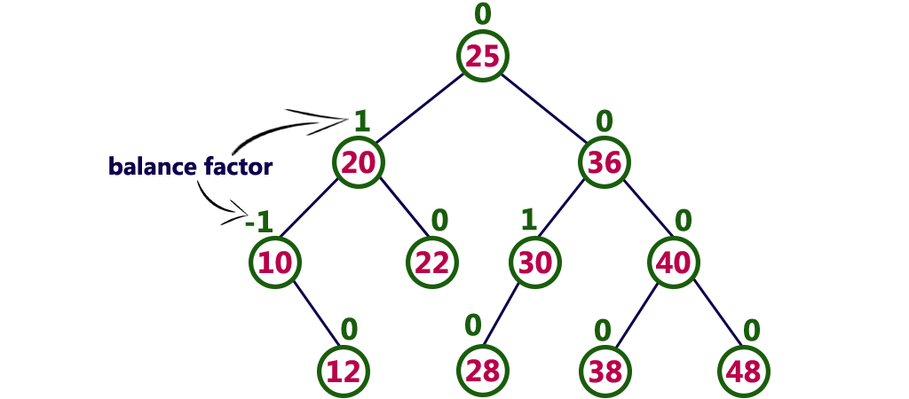
Example of AVL Trees
Every AVL Tree is a binary search tree but every Binary Search Tree need not be AVL tree.

Slide 8

AVL Tree Rotations
When performing operations like insertion and deletion - check the balance factor of every node in the tree.
If not Balanced,What should be done??
Rotation operations is done to make the tree balanced
What is Rotation??
Rotation is the process of moving nodes either to left or to right to make the tree balanced.

Slide 9

Classification of Rotations
Single Rotation
Left Rotation(LL Rotation)
Right Rotation(RR Rotation)
Double Rotation
Left Right Rotation(LR Rotation)
Right Left Rotation(RL Rotation)

Slide 10

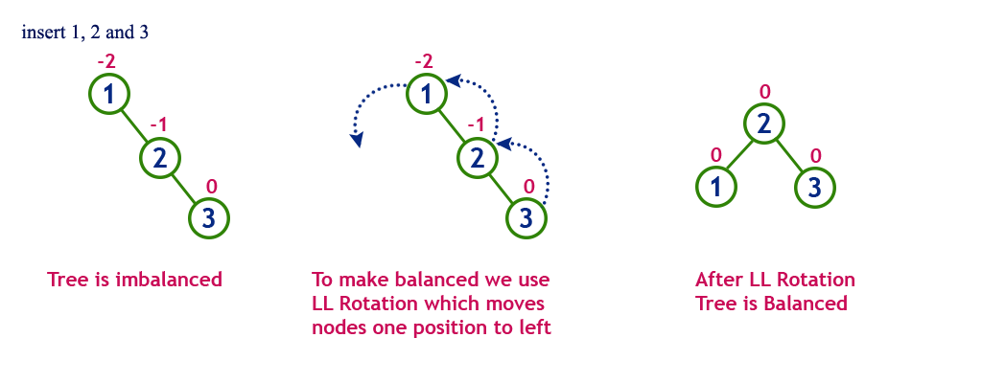
Single Left Rotation (LL Rotation)
Every node moves one position to left from the current position

Slide 11
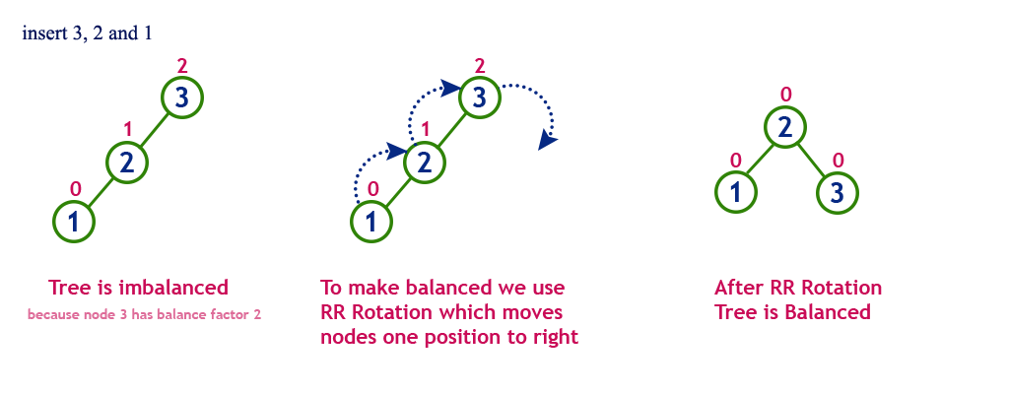
Single Right Rotation (RR Rotation)
Every node moves one position to right from the current position

Slide 12

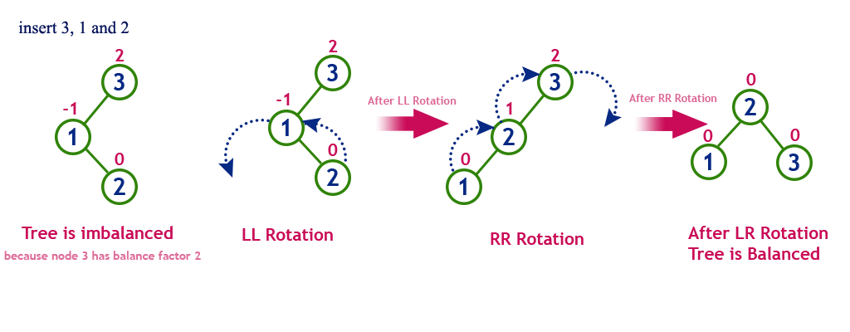
Double Rotation- Left Right Rotation
(LR Rotation)
Sequence of single left rotation followed by a single right rotation
Every node moves one position to the left and one position to right from the current position

Slide 13
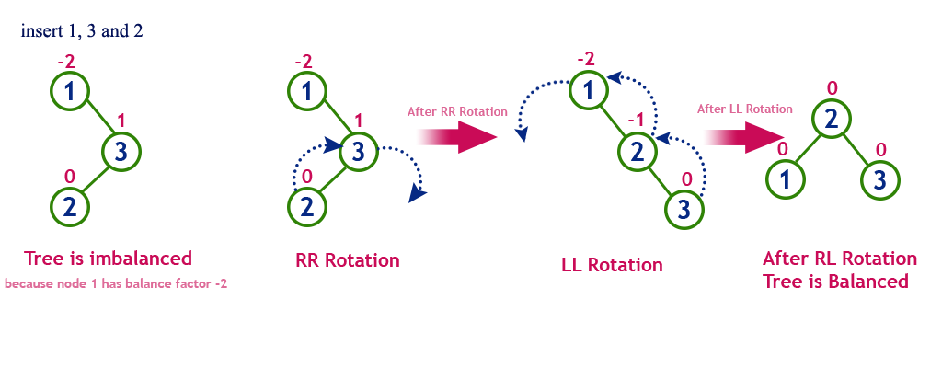
Double Rotation- Right Left Rotation
(RL Rotation)
Sequence of single right rotation followed by a single left rotation
Every node moves one position to the right and one position to left from the current position

Slide 14

Operations on AVL Tree
Insertion
Search
Deletion

Slide 15

Insertion Operation
As in BST, a new node is always inserted as a leaf node.
Step 1 - Insert the new element into the tree using Binary Search Tree insertion logic.
Step 2 - After insertion, check the Balance Factor of every node.
Step 3 - If the Balance Factor of every node is 0 or 1 or -1 then go for next operation.
Step 4 - If the Balance Factor of any node is other than 0 or 1 or -1 then that tree is said to be imbalanced. In this case, perform suitable Rotation to make it balanced and go for next operation.

Slide 16


Construction of AVL Tree (1 to 8)
Insert 1
BF=0
1
TREE is Balanced
Insert 2
BF=-1
1
BF=0
2
TREE is Balanced

Slide 17
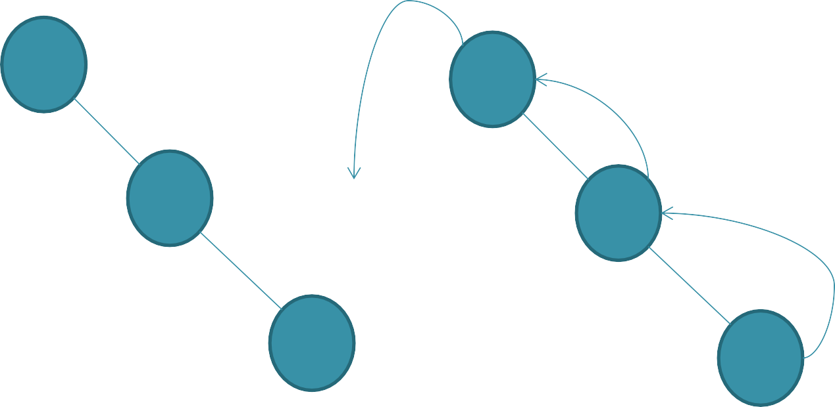
Construction of AVL Tree (1 to 8)
Insert 3
BF=-2
BF=-2
1
1
BF=-1
BF=-1
2
2
BF=0
BF=0
3
3
TREE is imbalanced
BF=0
LL ROTATION
2
BF=0
BF=0
1
3
TREE is balanced

Slide 18
Construction of AVL Tree (1 to 8)
Insert 4
BF=-1
2
BF=0
BF=-1
1
3
BF=0
4
TREE is balanced

Slide 19

Construction of AVL Tree (1 to 8)
Insert 5
BF=-2
BF=-2
2
2
BF=0
1
BF=-2
3
BF=0
1
BF=-2
3
BF=-1
BF=-1
4
4
BF=0
BF=0
5
5
LL ROTATION AT 3
TREE is imbalanced

Slide 20
Construction of AVL Tree (1 to 8)
Result of Inserting 5
BF=-1
2
BF=0
BF=0
1
4
BF=0
BF=0
3
5
TREE is balanced

Slide 21

Construction of AVL Tree (1 to 8)
Insert 6
BF=-2
2
BF=0
BF=-1
1
4
BF=0
BF=-1
3
5
BF=0
6
TREE is imbalanced

Slide 22
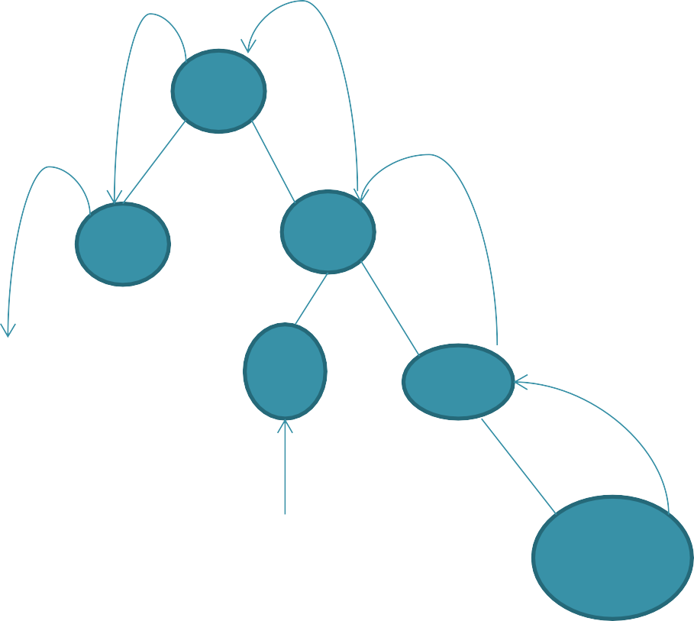
Construction of AVL Tree (1 to 8)
Rotation process at Inserting 6
BF=-2
2
BF=0
BF=-1
1
4
BF=0
BF=-1
3
5
??
BF=0
6
LL Rotation at 2

Slide 23
Construction of AVL Tree (1 to 8)
Result of Inserting 6
BF=0
4
BF=0
BF=-1
2
5
BF=0
BF=0
BF=0
6
1
3
TREE is balanced

Slide 24
Construction of AVL Tree (1 to 8)
Insert 7
BF=-1
4
BF=0
BF=-2
2
5
BF=0
BF=0
BF=-1
6
1
3
BF=0
7
TREE is imbalanced

Slide 25
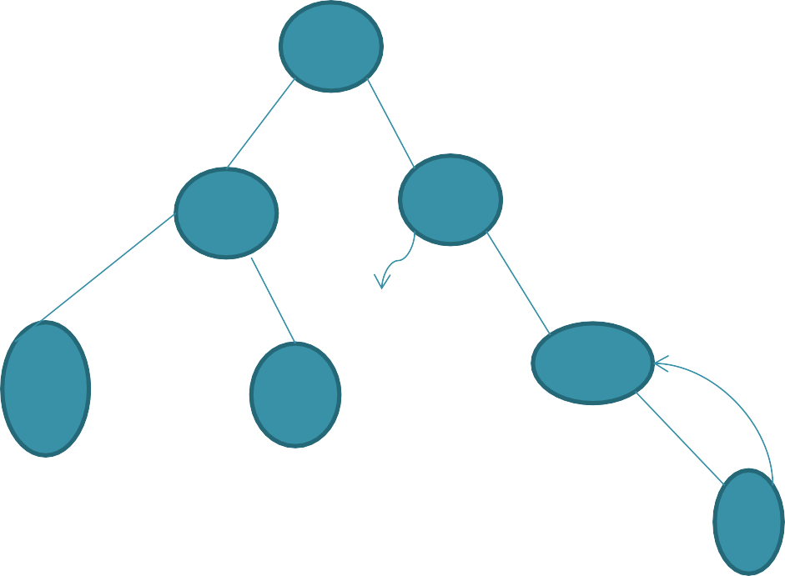
Construction of AVL Tree (1 to 8)
Rotation Process when Inserting 7
BF=-1
4
BF=0
BF=-2
2
5
BF=0
BF=0
BF=-1
6
1
3
BF=0
7
LL Rotation at 5

Slide 26
Construction of AVL Tree (1 to 8)
Result of Inserting 7
BF=0
4
BF=0
BF=0
2
6
BF=0
BF=0
BF=0
5
BF=0
1
7
3
TREE is balanced

Slide 27
Construction of AVL Tree (1 to 8)
Insert 8
BF=-1
4
BF=0
BF=-1
2
6
BF=0
BF=0
BF=0
5
BF=-1
1
7
3
BF=0
8
TREE is balanced

Slide 28

Deletion Operation
Similar to deletion operation in BST
Every deletion operation, we need to check with the Balance Factor condition
If the tree is balanced after deletion go for next operation otherwise perform suitable rotation to make the tree Balanced.

